Slide 1
CHAPTER Mathematics
2 for Microeconomics

Slide 2
Maximization of a Function of One Variable
Economic theories assume that
  An economic agent is seeking to find the optimal value of some function
    Consumers seek to maximize utility
    Firms seek to maximize profit
Simple example,𝜋 = 𝑓(𝑞)
  Manager of a firm wants to maximize profits
    The profits (π) received depend only on the quantity (q) of the good sold

Slide 3
2.1 Hypothetical Relationship between Quantity
Produced and Profits
π
π*
π₂
π = f(q)
π₃
π₁
Quantity
q₁
q₂
q*
q₃
If a manager wishes to produce the level of output that maximizes profits, then q* should be produced. Notice that at q*, dπ/dq = 0.

Slide 4
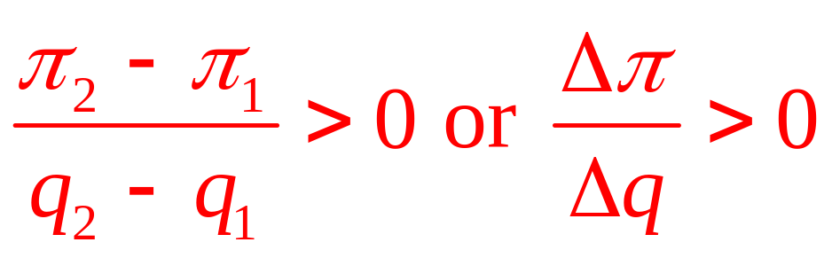
Maximization of a Function of One Variable
Vary q to see where maximum profit occurs
  An increase from q₁ to q₂ leads to a rise in π

Slide 5
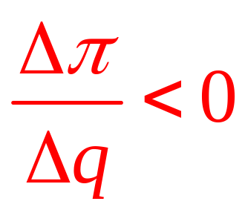
Maximization of a Function of One Variable
If output is increased beyond q*, profit will decline
  An increase from q* to q₃ leads to a drop in π

Slide 6
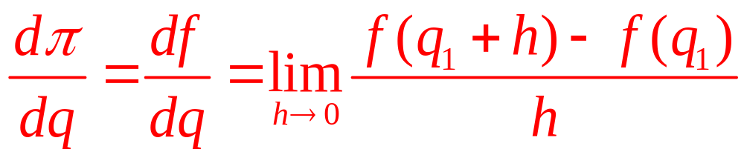
Maximization of a Function of One Variable
Derivatives
  The derivative of π = f(q) is the limit of Δπ/Δq for very small changes in q
  Is the slope of the curve
  The value depends on the value of q₁
  The derivative of π = f(q) at the point q₁ is:

Slide 7
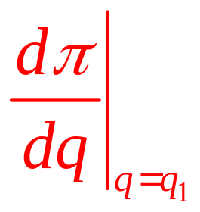
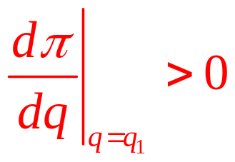
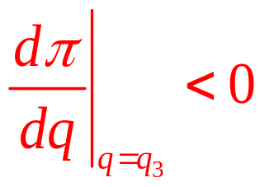
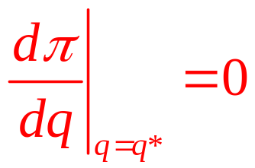
Maximization of a Function of One Variable
Value of a derivative at a point (the slope)
  The evaluation of the derivative at the point
  q = q₁ can be denoted
  In our previous example,

Slide 8
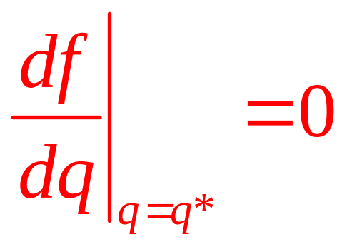
Maximization of a Function of One Variable
First-order condition for a maximum
  For a function of one variable to attain its maximum value at some point, the derivative at that point must be zero

Slide 9
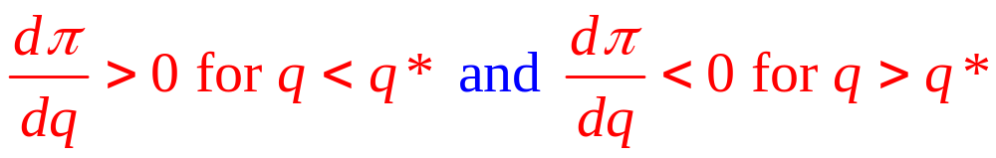
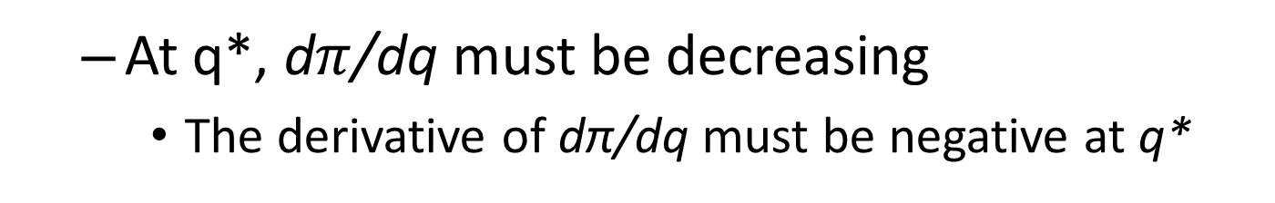
Maximization of a Function of One Variable
The first order condition (dπ/dq)
  Is a necessary condition for a maximum
  But it is not a sufficient condition
The second order condition
  In order for q* to be the optimum,
  At q*, d$π$/dq must be decreasing
    The derivative of dπ/dq must be negative at q*

Slide 10
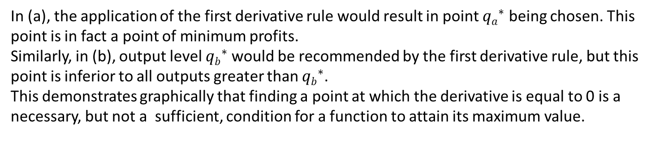
2.2 Two Profit Functions That Give Misleading
Results If the First Derivative Rule Is
Applied Uncritically
π
π
π_{a}*
π_{b}*
q_{a}*
q_{b}*
(a) Quantity
(b) Quantity
In (a), the application of the first derivative rule would result in point ${qa}_{}^{∗}$ being chosen. This point is in fact a point of minimum profits.
Similarly, in (b), output level ${qb}_{}^{∗}$would be recommended by the first derivative rule, but this point is inferior to all outputs greater than ${qb}_{}^{∗}$.
This demonstrates graphically that finding a point at which the derivative is equal to 0 is a necessary, but not a sufficient, condition for a function to attain its maximum value.

Slide 11
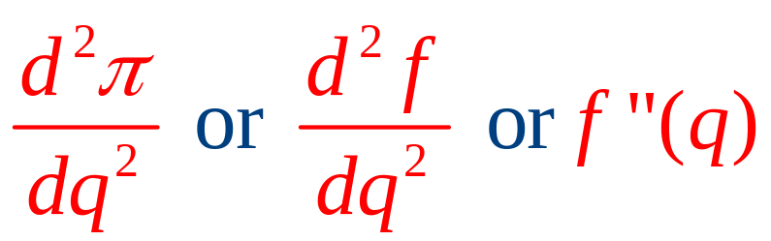
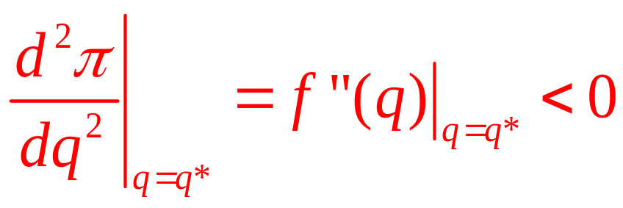
Maximization of a Function of One Variable
Second derivative
  The derivative of a derivative
  Can be denoted by:
The second order condition
  To represent a (local) maximum is:

Slide 12
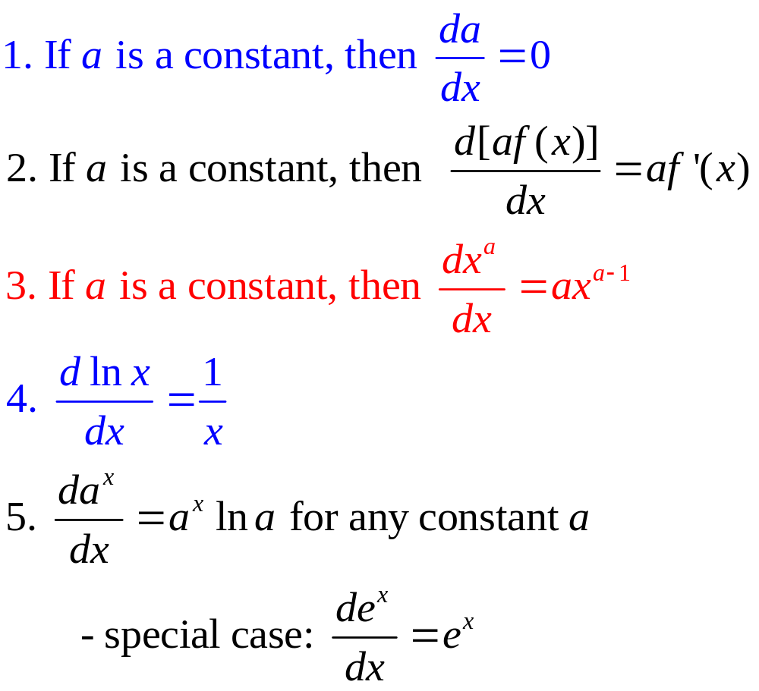
Rules for Finding Derivatives

Slide 13
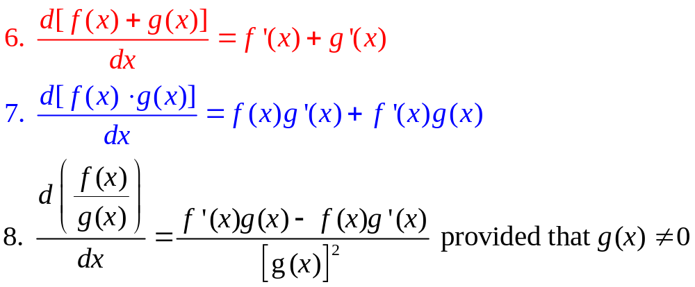
Rules for Finding Derivatives
Suppose that f(x) and g(x) are two functions of x and f’(x) and g’(x) exist, then:

Slide 14
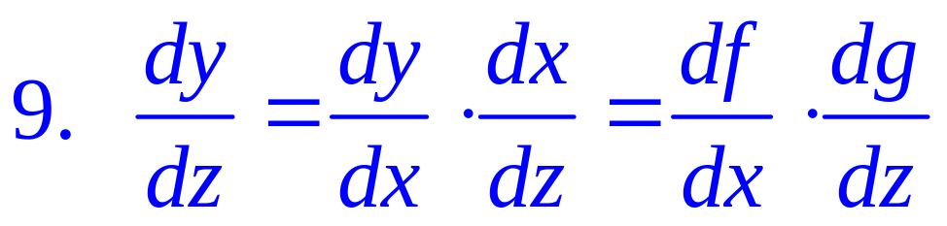
Rules for Finding Derivatives
If y = f(x) and x = g(z) and if both f’(x) and g’(x) exist, then:
This is called the chain rule
  Allows us to study how one variable (z) affects another variable (y) through its influence on some intermediate variable (x)

Slide 15
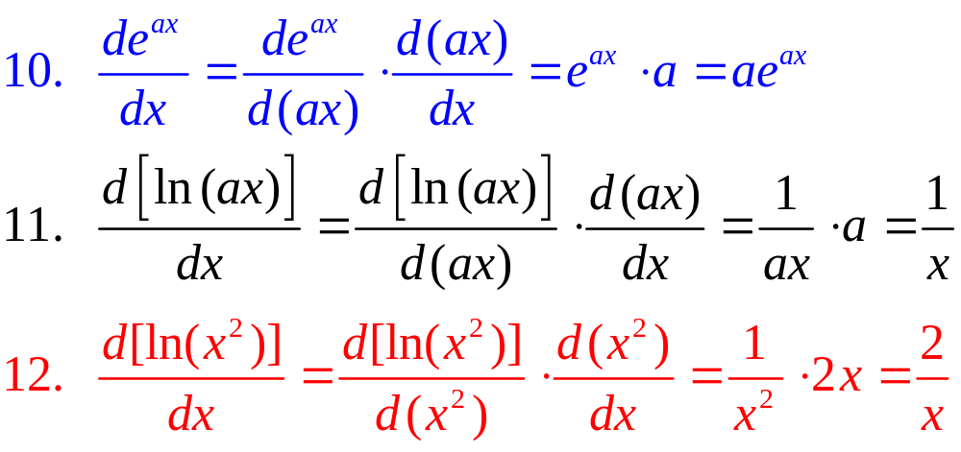
Rules for Finding Derivatives
Some examples of the chain rule include:

Slide 16
2.1 Profit Maximization
Suppose that the relationship between profit and output is
π = 1,000q - 5q²
The first order condition for a maximum is
dπ/dq = 1,000 - 10q = 0
q* = 100
Since the second derivative is always -10, then q = 100 is a global maximum

Slide 17
Functions of Several Variables
Most goals of economic agents depend on several variables
  Trade-offs must be made
The dependence of one variable (y) on a series of other variables (x₁,x₂,…,x_{n}) is denoted by
y = f(x₁, x₂,…,x_{n})

Slide 18
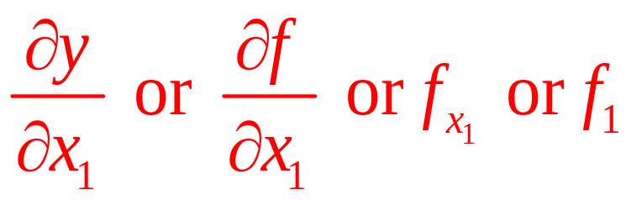
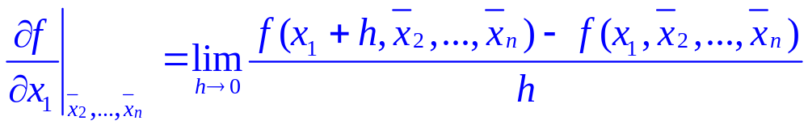
Functions of Several Variables
Partial derivatives
  Partial derivative of y with respect to x₁:
  All of the other x’s are held constant
A more formal definition is

Slide 19
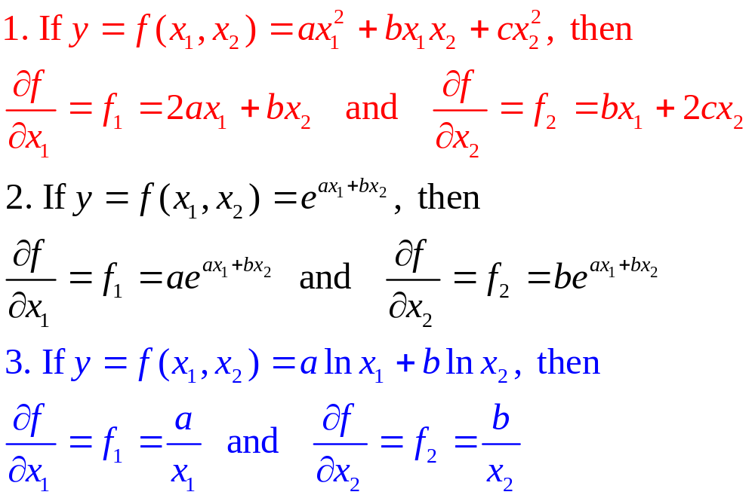
Calculating Partial Derivatives

Slide 20
Functions of Several Variables
Partial derivatives
  Are the mathematical expression of the ceteris paribus assumption
    Law of demand: 𝜕𝑞/𝜕𝑝<0, ceteris paribus
  Show how changes in one variable affect some outcome when other influences are held constant
We must be concerned with units of measurement

Slide 21
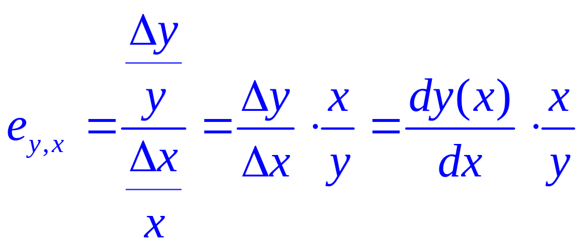
Functions of Several Variables
Elasticity
  Measures the proportional effect of a change in one variable on another
  Unit free
  Of y with respect to x is

Slide 22
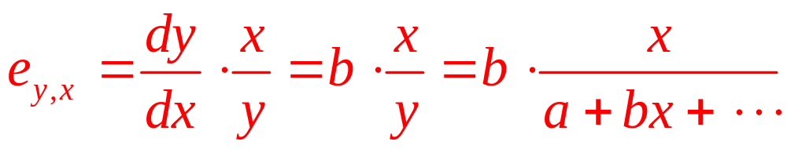
2.2 Elasticity and Functional Form
For: 𝑦 = 𝑎 + 𝑏𝑥 + 𝑜𝑡ℎ𝑒𝑟 𝑡𝑒𝑟𝑚𝑠
The elasticity is:
  e_{y,x} is not constant
  It is important to note the point at which the elasticity is to be computed

Slide 23
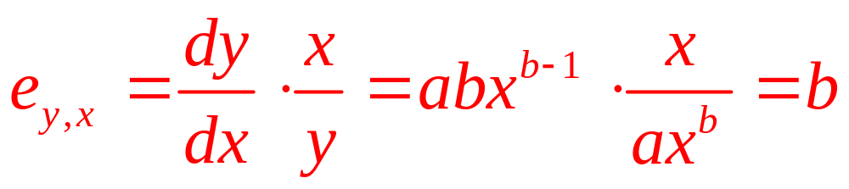
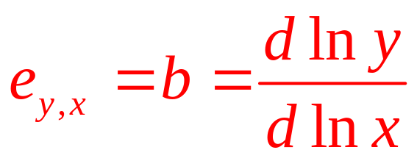
2.2 Elasticity and Functional Form
For 𝑦 = 𝑎𝑥^{𝑏}
  The elasticity is a constant:
For ln⁡𝑦 = ln⁡𝑎 + 𝑏 ln⁡𝑥
  The elasticity is:
Elasticities can be calculated through logarithmic differentiation

Slide 24
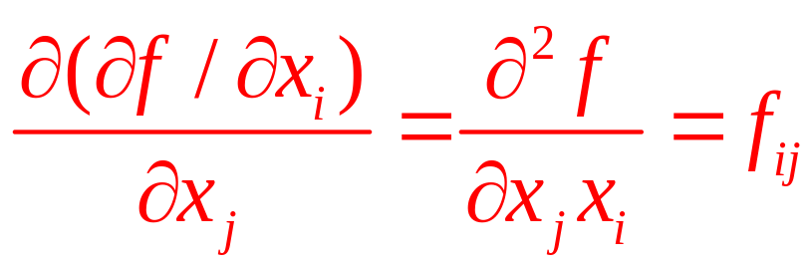
Functions of Several Variables
Second-order partial derivatives
  The partial derivative of a partial derivative

Slide 25
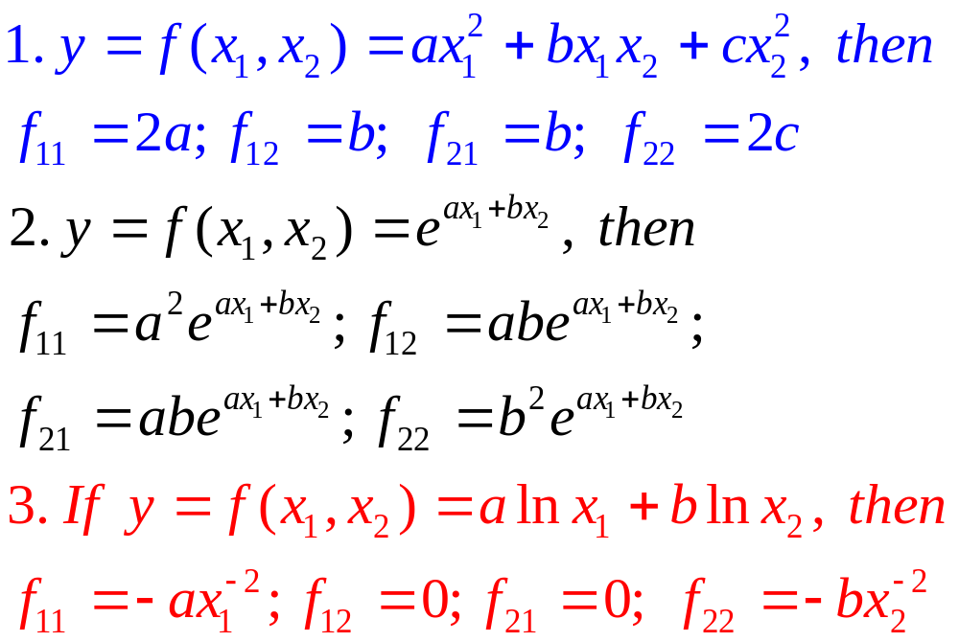
Second-order partial derivatives

Slide 26
Functions of Several Variables
Young’s theorem
  Under general conditions
  The order in which partial differentiation is conducted to evaluate second-order partial derivatives does not matter
𝑓_{𝑖𝑗}= 𝑓_{𝑗𝑖}

Slide 27
Functions of Several Variables
Uses of second-order partials
  Play an important role in many economic theories
  A variable’s own second-order partial, f_{ii}
    Shows how ∂y/∂x_{i} changes as the value of x_{i} increases
    f_{ii} < 0 indicates diminishing marginal effectiveness
  Cross-partial f_{ij} indicates how the marginal effectiveness of x_{i} changes as x_{j} increases

Slide 28
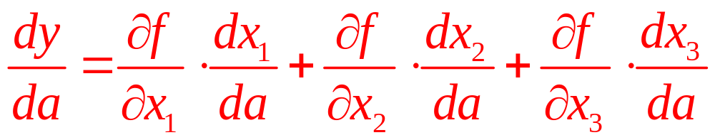
Functions of Several Variables
The chain rule with many variables
  𝑦 = 𝑓(𝑥₁,𝑥₂,𝑥₃)
    Each of these x’s is itself a function of a single parameter, a
  𝑦 = 𝑓[𝑥₁(𝑎),𝑥₂(𝑎),𝑥₃(𝑎)]
  How a change in a affects the value of y:

Slide 29
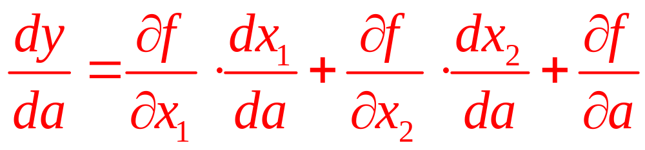
Functions of Several Variables
Special case: if 𝑥₃ = 𝑎, then:
𝑦 = 𝑓[𝑥₁(𝑎),𝑥₂(𝑎),𝑎]
  The effect of a on y:
    A direct effect (which is given by f_{a})
    An indirect effect that operates only through the ways in which a affects the x’s

Slide 30
Functions of Several Variables
Implicit functions
  If the value of a function is held constant
    An implicit relationship is created among the independent variables that enter into the function
    The independent variables can no longer take on any values
      But must instead take on only that set of values that result in the function’s retaining the required value

Slide 31
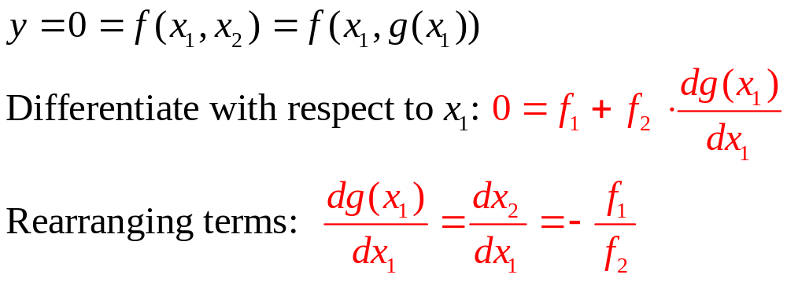
Functions of Several Variables
Implicit functions
  Ability to quantify the trade-offs inherent in most economic models
y = f(x₁,x₂); Implicit function: x₂=g(x₁)

Slide 32
2.3 Using the Chain Rule
A pizza fanatic
  Each week, he consumes three kinds of pizza, denoted by x₁, x₂, and x₃
    Cost of type 1 pizza is p per pie
    Cost of type 2 pizza is 2p
    Cost of type 3 pizza is 3p
  Allocates $30 each week to each type of pizza
  How the total number of pizzas purchased is affected by the underlying price p

Slide 33
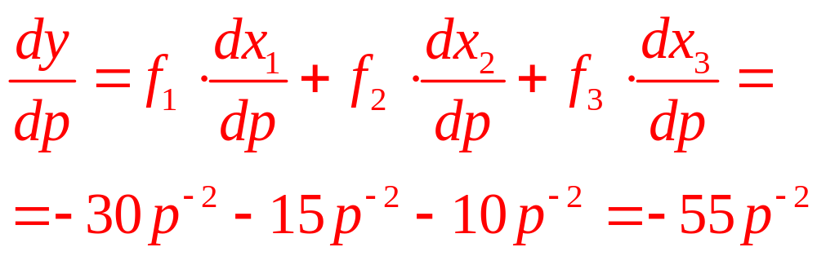
2.3 Using the Chain Rule
Quantity purchased of each type:
  x₁=30/p; x₂=30/2p; x₃=30/3p
Total pizza purchases:
  y = f[x₁(p), x₂(p), x₃(p)] = x₁(p) + x₂(p) + x₃(p)
Applying the chain rule:

Slide 34
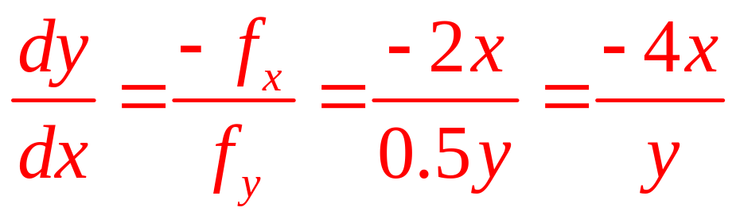
2.4 A Production Possibility Frontier—Again
A production possibility frontier for two goods of the form
x²+0.25y²=200
The implicit function:

Slide 35
Functions of Several Variables
Comparative statics analysis
  From 𝑦=0=𝑓(𝑥₁,𝑥₂)=𝑓(𝑥₁,𝑔(𝑥₁ ))
  Exogenous variable, a , the implicit form is
  𝑓(𝑥(𝑎), 𝑎)=0
  Applying the implicit function theorem would yield: 𝑑𝑥(𝑎)/𝑑𝑎=−𝑓_{𝑎}/𝑓_{𝑥}
    This shows directly how changes in the exogenous variable a affect the endogenous variable x.

Slide 36
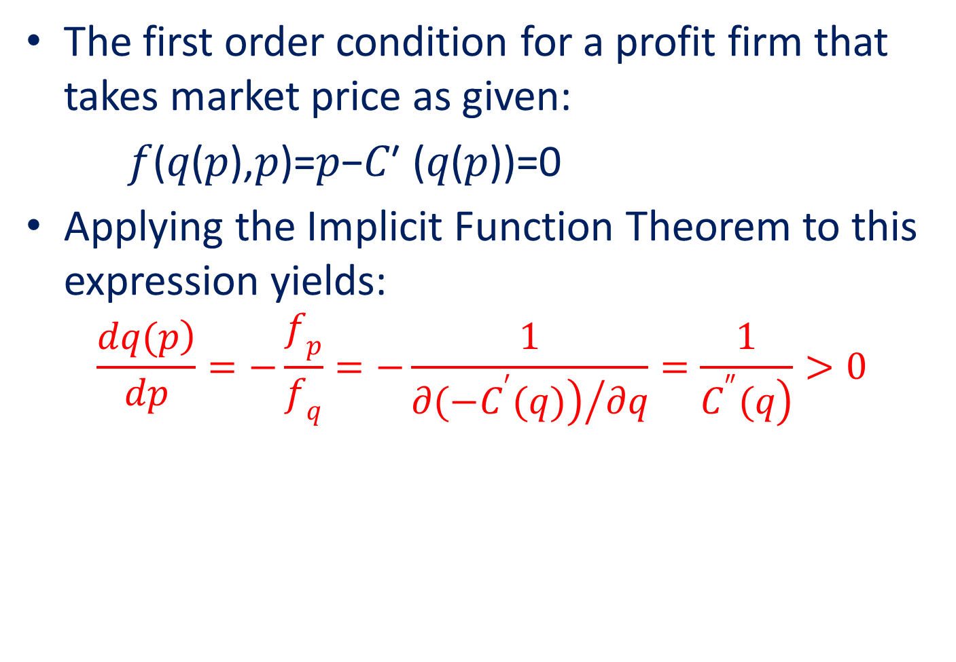
2.5 Comparative Statics of a Price-Taking Firm
The first order condition for a profit firm that takes market price as given:
𝑓(𝑞(𝑝),𝑝)=𝑝−𝐶′ (𝑞(𝑝))=0
Applying the Implicit Function Theorem to this expression yields:
$$\frac{\left.dq(p\right)}{dp}=−\frac{f_{p}}{f_{q}}=−\frac{1}{{\left.∂(−C^{′}(q)\right)}/{∂q}}=\frac{1}{\left.C^{″}(q\right)}>0$$

Slide 37
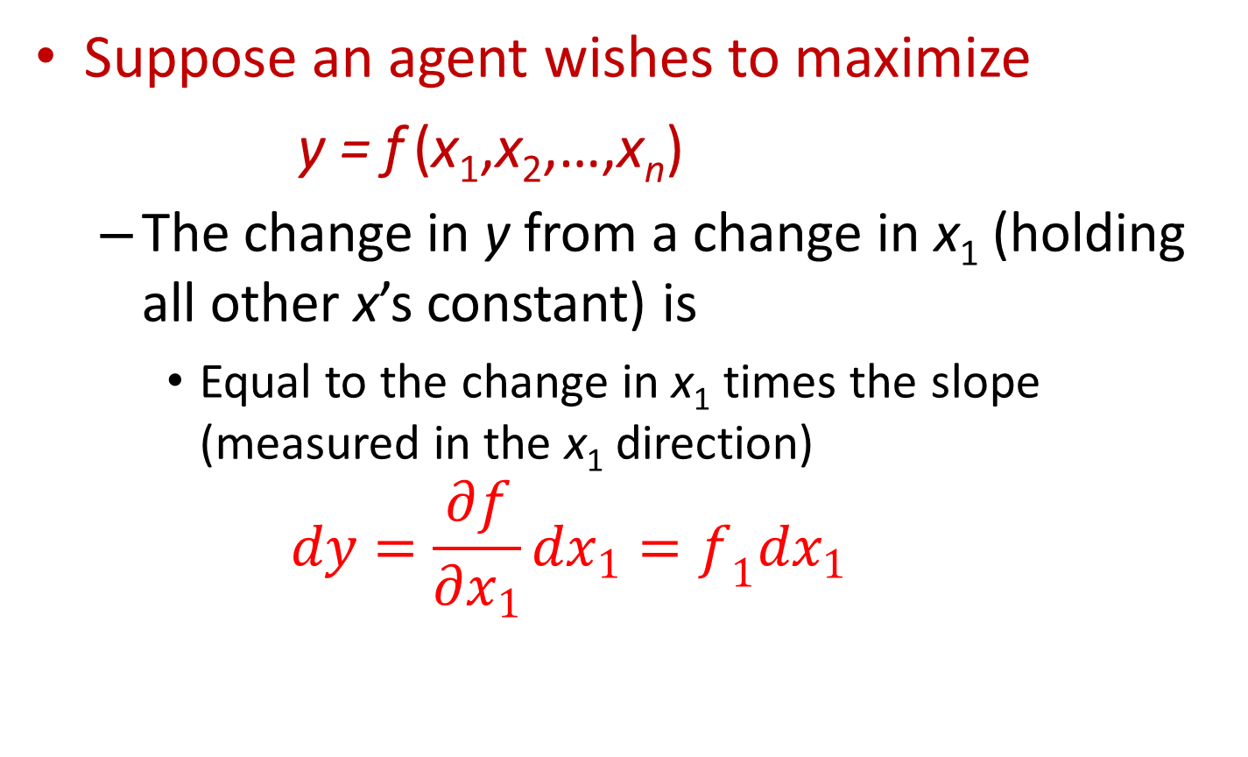
Maximization of Functions of Several Variables
Suppose an agent wishes to maximize
$\text{y}\text{ = }\text{f} \text{(}\text{x}\text{1}\text{,}\text{x}\text{2}\text{,…,}\text{x}\text{n}\text{)}$
  The change in y from a change in x₁ (holding all other x’s constant) is
    Equal to the change in x₁ times the slope (measured in the x₁ direction)
    $$dy=\frac{∂f}{∂x_{1}}dx_{1}=f_{1}dx_{1}$$

Slide 38
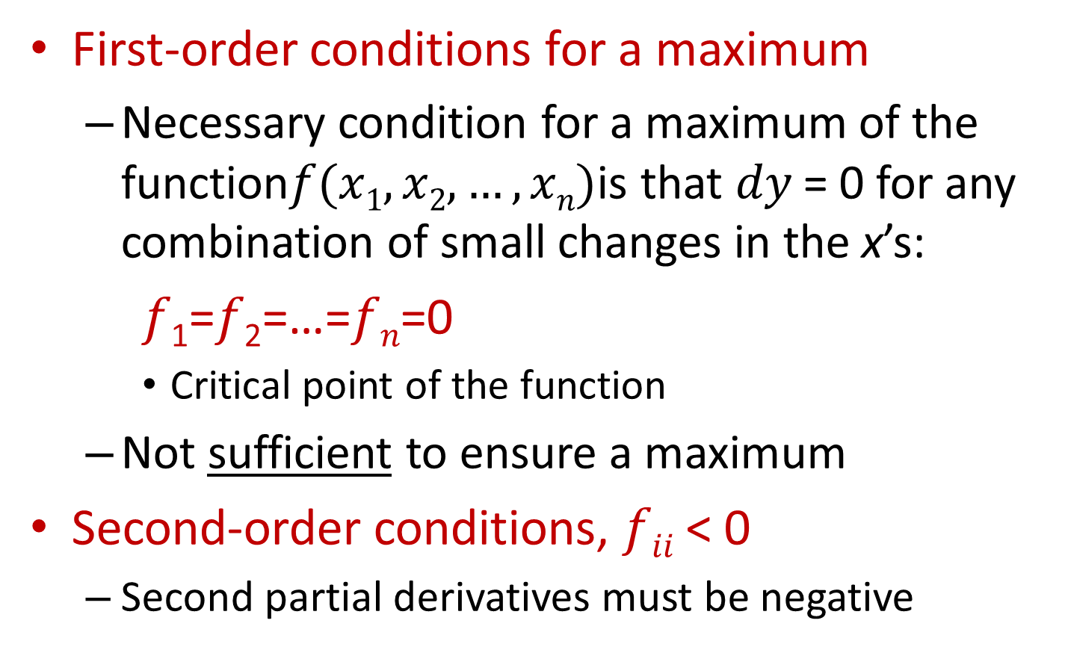
Maximization of Functions of Several Variables
First-order conditions for a maximum
  Necessary condition for a maximum of the function$f(x1,x2,…,xn)$is that 𝑑𝑦 = 0 for any combination of small changes in the x’s:
𝑓₁=𝑓₂=…=𝑓_{𝑛}=0
    Critical point of the function
  Not sufficient to ensure a maximum
Second-order conditions, 𝑓_{𝑖𝑖} < 0
  Second partial derivatives must be negative

Slide 39
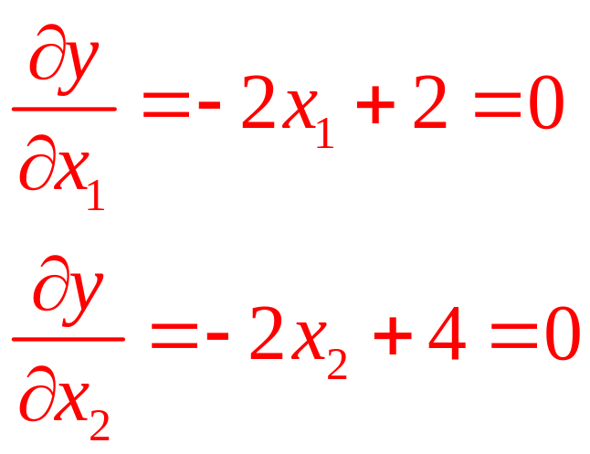
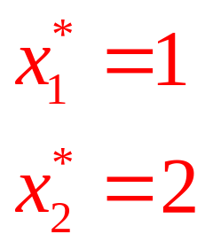
2.6 Finding a Maximum
Suppose that y is a function of x₁ and x₂
  𝑦 = − (𝑥₁ − 1)² − (𝑥₂ − 2)² + 10
  𝑦 = − 𝑥₁² + 2𝑥₁ − 𝑥₂² + 4𝑥₂ + 5
First-order conditions imply that
OR

Slide 40
The Envelope Theorem
The envelope theorem
  How an optimized function changes when a parameter of the function changes
A specific example: 𝑦 = −𝑥² + 𝑎𝑥
  Represents a family of inverted parabolas
    For different values of a
  Is a function of x only
    If a is assigned a specific value
    Can calculate the value of x that maximizes y

Slide 41
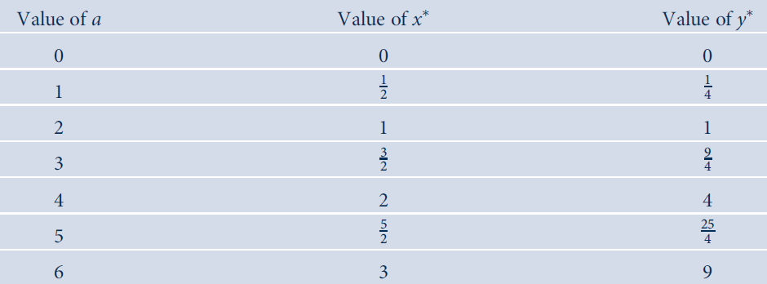
2.1 Optimal values of y and x for alternative values of a in y=-x²+ax

Slide 42
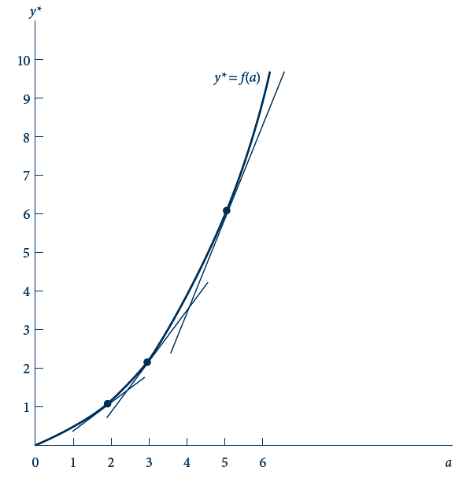
2.3 Illustration of the Envelope Theorem
The envelope theorem states that the slope of the relationship between y (the maximum value of y) and the parameter a can be found by calculating the slope of the auxiliary relationship found by substituting the respective optimal values for x into the objective function and calculating ∂y/∂a.

Slide 43
The Envelope Theorem
If we are interested in how y* changes as a changes
  Calculate the slope of y directly (time-consuming approach)
  Hold x constant at its optimal value and calculate ∂y/∂a directly (the envelope shortcut)

Slide 44
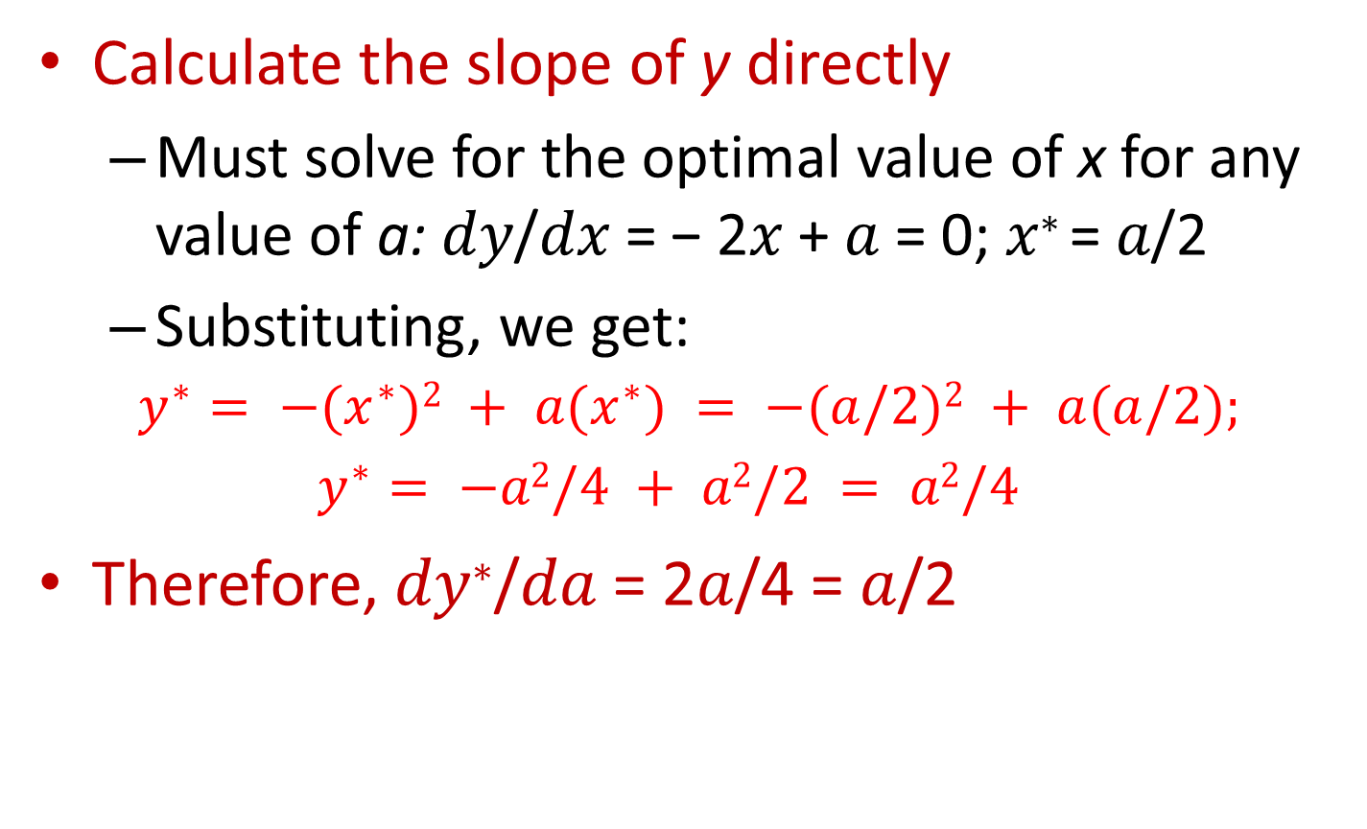
The Envelope Theorem
Calculate the slope of y directly
  Must solve for the optimal value of x for any value of a: 𝑑𝑦/𝑑𝑥 = − 2𝑥 + 𝑎 = 0; 𝑥∗ = 𝑎/2
  Substituting, we get:
$$y^{∗}= −(x^{∗})2 + a(x^{∗}) = −(a/2)2 + a(a/2);$$
$$y^{∗}= −a2/4 + a2/2 = a2/4$$
Therefore, 𝑑𝑦∗/𝑑𝑎 = 2𝑎/4 = 𝑎/2

Slide 45
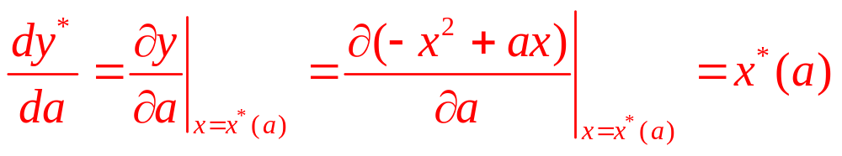

The Envelope Theorem
The envelope shortcut
  For small changes in a, dy*/da can be computed by holding x at its optimal value (x*) and calculating ∂y/∂a directly from y
  Holding x = x*: $\frac{dy}{da}= x^{∗}(a) = a/2$

Slide 46
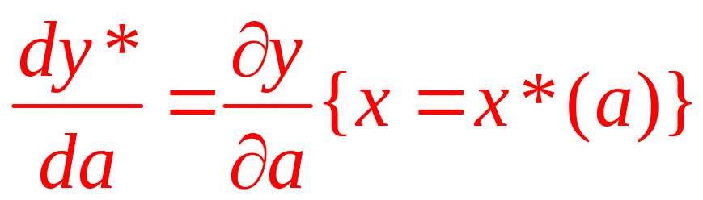
The Envelope Theorem
The envelope theorem
  The change in the value of an optimized function with respect to a parameter of that function
  Can be found by partially differentiating the objective function while holding x (or several x’s) at its optimal value

Slide 47
The Envelope Theorem
Many-variable case
  y is a function of several variables
  y = f(x₁,…x_{n},a)
  Finding an optimal value for y: solve n first-order equations:
  ∂y/∂x_{i} = 0 (i = 1,…,n)
  Optimal values for these x’s would be a function of a
x₁* = x₁*(a); x₂* = x₂*(a); …; x_{n}* = x_{n}*(a)

Slide 48
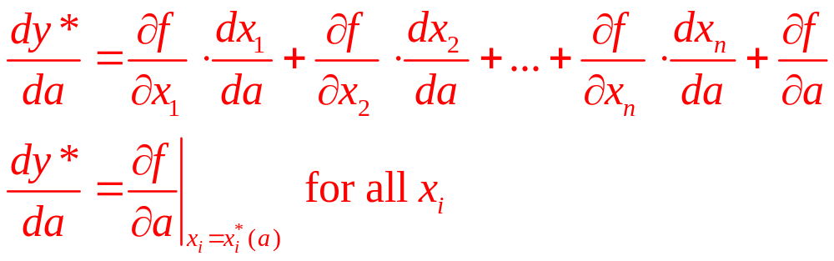
The Envelope Theorem
Many-variable case
  Substituting into the original objective function gives us the optimal value of y (say, y*), we get the value function:
  y* = f [x₁*(a), x₂*(a),…,x_{n}*(a),a]
  Differentiating yields

Slide 49
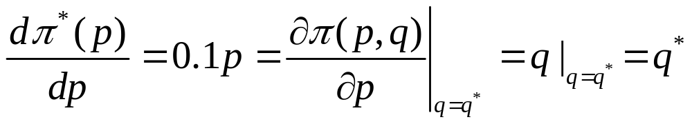
2.7 A Price-Taking Firm’s Supply Function
Cost function 𝐶(𝑞)=5𝑞²
  First order condition: 𝑝=𝐶′ (𝑞)=10𝑞, we get 𝑞∗=0.1𝑝
Alternatively:
  Profits are given by: 𝜋(𝑝,𝑞)=𝑝𝑞−𝐶(𝑞)
  Calculate the optimal value of the firm’s profits:
𝜋∗ (𝑝)=𝑝𝑞∗−𝐶(𝑞∗)=𝑝(0.1𝑝)−5(0.1𝑝)²=.05𝑝²
The envelope theorem states that

Slide 50
Constrained Maximization
What if all values for the x’s are not feasible?
  The values of x may all have to be > 0
  A consumer’s choices are limited by the amount of purchasing power available
Lagrange multiplier method
  One method used to solve constrained maximization problems

Slide 51
Lagrange Multiplier Method
Lagrange multiplier method
  Suppose that we wish to find the values of x₁, x₂,…, x_{n} that maximize: 𝑦 = 𝑓(𝑥₁, 𝑥₂,…, 𝑥_{𝑛})
  Subject to a constraint: 𝑔(𝑥₁, 𝑥₂,…, 𝑥_{𝑛}) = 0
The Lagrangian expression
ℒ = 𝑓(𝑥₁, 𝑥₂,…, 𝑥_{𝑛} ) + λ 𝑔(𝑥₁, 𝑥₂,…, 𝑥_{𝑛})
  λ is called the Lagrange multiplier
  ℒ = 𝑓, because 𝑔(𝑥₁, 𝑥₂,…, 𝑥_{𝑛}) = 0

Slide 52
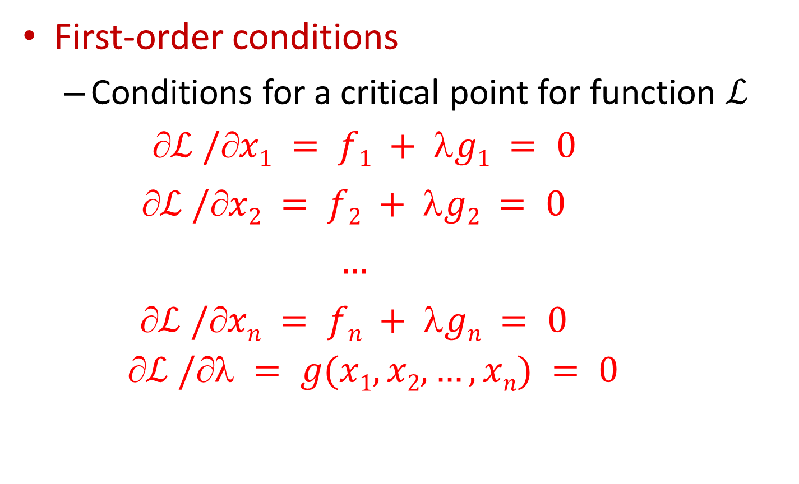
Lagrange Multiplier Method
First-order conditions
  Conditions for a critical point for function $ℒ$
    $$ℒ /x1 = f1 + g1 = 0$$
    $$ℒ /x2 = f2 + g2 = 0$$
    $$…$$
    $$ℒ /xn = fn + gn = 0$$
    $$ℒ / = g(x1, x2,…, xn) = 0$$

Slide 53
Lagrange Multiplier Method
First-order conditions
  Can generally be solved for x₁, x₂,…, x_{n} and λ
  The solution will have two properties:
    The x’s will obey the constraint
    These x’s will make the value of ℒ (and therefore f) as large as possible

Slide 54
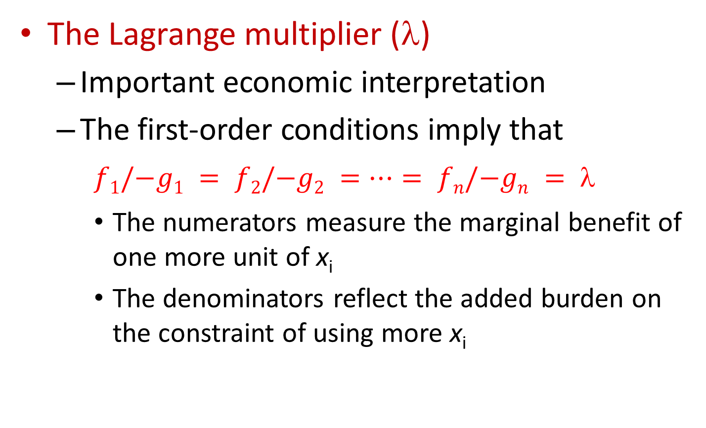
Lagrange Multiplier Method
The Lagrange multiplier (λ)
  Important economic interpretation
  The first-order conditions imply that
$f1/−g1 = f2/−g2 =…= fn/−gn = $
    The numerators measure the marginal benefit of one more unit of x_{i}
    The denominators reflect the added burden on the constraint of using more x_{i}

Slide 55
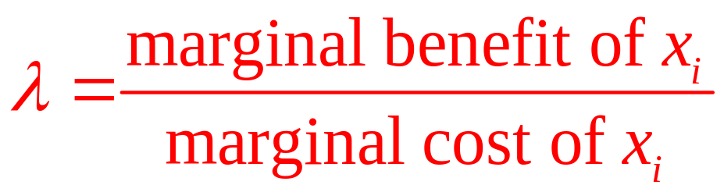
Lagrange Multiplier Method
The Lagrange multiplier (λ)
  At the optimal x_{i}’s, the ratio of the marginal benefit to the marginal cost of x_{i} should be the same for every x_{i}
  λ is the common cost-benefit ratio for all x_{i}

Slide 56
Lagrange Multiplier Method
The Lagrange multiplier (λ)
  A high value of λ indicates that each x_{i} has a high cost-benefit ratio
  A low value of λ indicates that each x_{i} has a low cost-benefit ratio
  λ = 0 implies that the constraint is not binding

Slide 57
Constrained Maximization
Duality
  Any constrained maximization problem has a dual problem in constrained minimization
    Focuses attention on the constraints in the original (primal) problem

Slide 58
Constrained Maximization
Individuals maximize utility subject to a budget constraint
  Dual problem: individuals minimize the expenditure needed to achieve a given level of utility
Firms minimize the cost of inputs to produce a given level of output
  Dual problem: firms maximize output for a given cost of inputs purchased

Slide 59
2.8 Optimal Fences and Constrained
Maximization
A farmer had a certain length of fence (P)
  Wishes to enclose the largest possible rectangular area, with x and y the lengths of the sides
  Choose x and y to maximize the area (A = x·y)
  Subject to the constraint that the perimeter is fixed at P = 2x + 2y

Slide 60
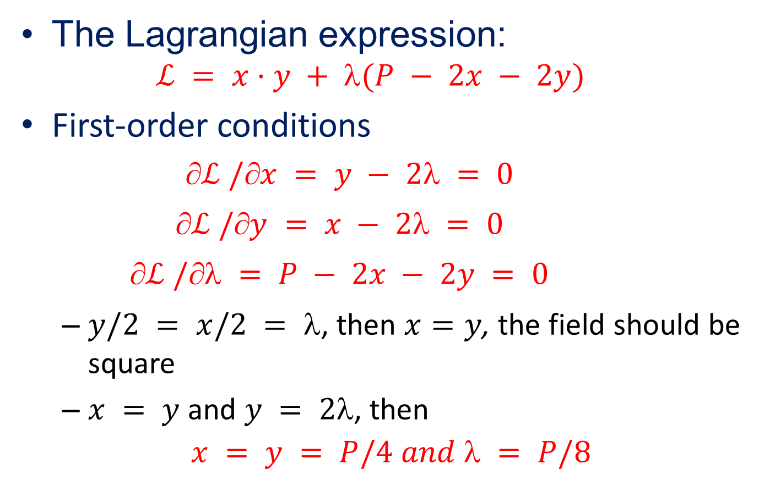
2.8 Optimal Fences and Constrained
Maximization
The Lagrangian expression:
  $$ℒ = x·y + (P − 2x − 2y)$$
First-order conditions
    $$ℒ /x = y − 2 = 0$$
    $$ℒ /y = x − 2 = 0$$
    $$ℒ / = P − 2x − 2y = 0$$
  $y/2 = x/2 = $, then $x=y$, the field should be square
  $x = y$ and $y = 2$, then
$$x = y = P/4 and  = P/8$$

Slide 61
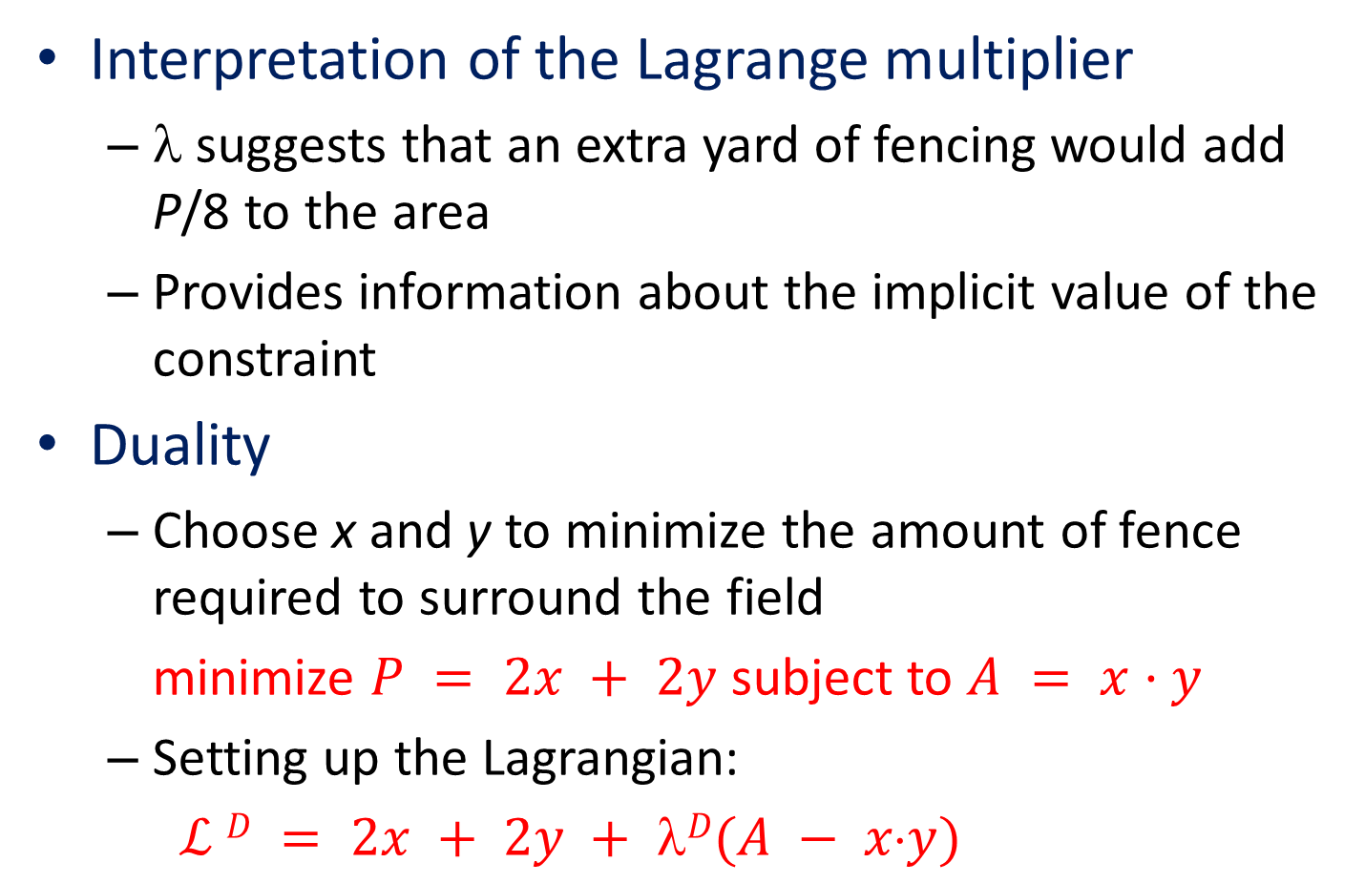
2.8 Optimal Fences and Constrained
Maximization
Interpretation of the Lagrange multiplier
  λ suggests that an extra yard of fencing would add P/8 to the area
  Provides information about the implicit value of the constraint
Duality
  Choose x and y to minimize the amount of fence required to surround the field
minimize $P = 2x + 2y$subject to $A = x·y$
  Setting up the Lagrangian:
  $ℒ D = 2x + 2y + D(A − xy)$

Slide 62
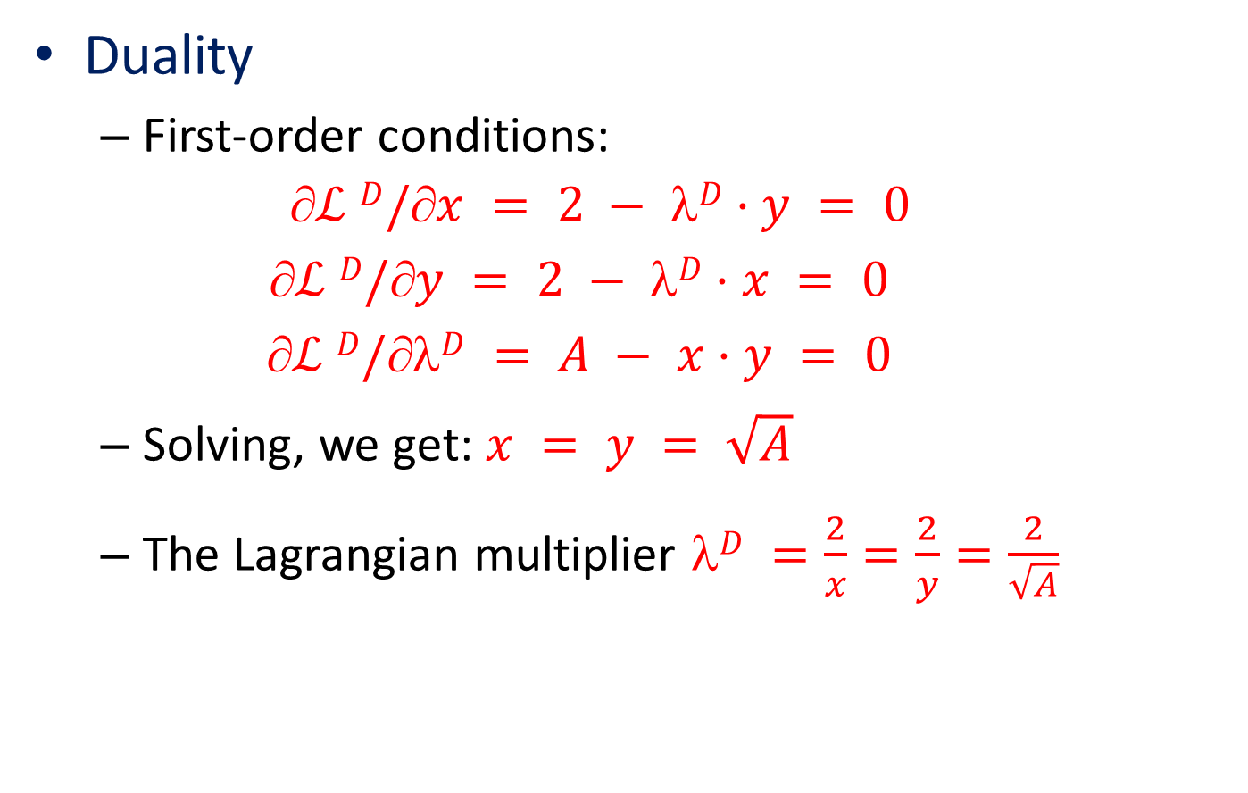
2.8 Optimal Fences and Constrained
Maximization
Duality
  First-order conditions:
  $$ℒ D/x = 2 − D·y = 0$$
  $$ℒ D/y = 2 − D·x = 0$$
  $$ℒ D/D = A − x·y = 0$$
  Solving, we get: $x = y = \sqrt{A}$
  The Lagrangian multiplier $D =\frac{2}{x}=\frac{2}{y}=\frac{2}{\sqrt{A}}$

Slide 63
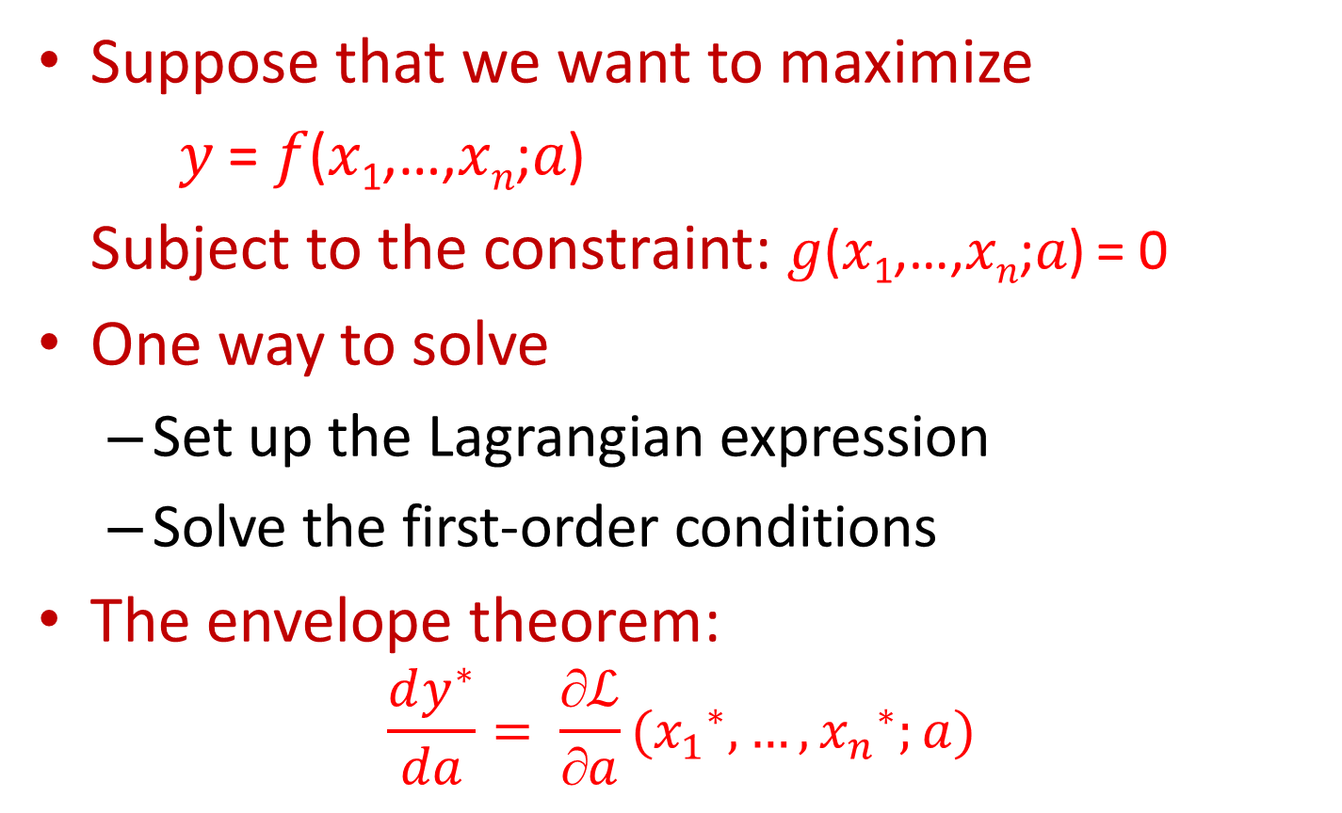
Envelope Theorem in Constrained
Maximization Problems
Suppose that we want to maximize
𝑦 = 𝑓(𝑥₁,…,𝑥_{𝑛};𝑎)
Subject to the constraint: 𝑔(𝑥₁,…,𝑥_{𝑛};𝑎) = 0
One way to solve
  Set up the Lagrangian expression
  Solve the first-order conditions
The envelope theorem:
$$\frac{dy^{∗}}{da}= \frac{∂ℒ}{∂a}({x_{1}}_{}^{∗},…,{x_{n}}_{}^{∗};a)$$

Slide 64

2.9 Optimal Fences and the Envelope
Theorem
The fencing problem (example 2.8), the value function: $A^{∗}=x^{∗}⋅y^{∗}=\frac{P}{4}⋅\frac{P}{4}=\frac{P^{2}}{16}$
  The Lagrangian: L =𝑥𝑦+𝜆(𝑃−2𝑥−2𝑦)
  Applying envelope theorem: 𝑑𝐴∗/𝑑𝑃=𝑃/8=∂𝐿/∂𝑃=𝜆
The Lagrange multiplier in a constrained maximization problem
  Shows the marginal gain in the objective function that can be obtained from a slight relaxation of the constrain

Slide 65
Inequality Constraints
Maximize 𝑦 = 𝑓(𝑥₁,𝑥₂) subject to
  𝑔(𝑥₁,𝑥₂) ≥ 0, 𝑥₁ ≥ 0, 𝑎𝑛𝑑 𝑥₂ ≥ 0
Slack variables
  Introduce three new variables (a, b, and c) that convert the inequalities into equalities
  Square these new variables
  𝑔(𝑥₁,𝑥₂) − 𝑎² = 0; 𝑥₁ − 𝑏² = 0; 𝑎𝑛𝑑 𝑥₂ − 𝑐² = 0
  Any solution that obeys these three equality constraints will also obey the inequality constraints

Slide 66

Inequality Constraints
Maximize 𝑦 = 𝑓(𝑥₁,𝑥₂) subject to
  $\text{g}\text{(}\text{x}\text{1}\text{,}\text{x}\text{2}\text{) ≥ 0, }\text{x}\text{1}\text{ ≥ 0, }\text{and} \text{x}\text{2}\text{ ≥ 0}$
Lagrange multipliers
ℒ = f(x₁,x₂)+ λ₁[g(x₁,x₂) - a²]+λ₂[x₁ - b²]+ λ₃[x₂ - c²]
  There will be 8 first-order conditions
∂ℒ /∂x₁ = f₁ + λ₁g₁ + λ₂ = 0 ∂ℒ /∂c = -2cλ₃ = 0
∂ℒ /∂x₂ = f₁ + λ₁g₂ + λ₃ = 0 ∂ℒ /∂λ₁ = g(x₁,x₂) - a² = 0
∂ℒ /∂a = -2aλ₁ = 0 ∂ℒ /∂λ₂ = x₁ - b² = 0
∂ℒ /∂b = -2bλ₂ = 0 ∂ℒ /∂λ₃ = x₂ - c² = 0

Slide 67
Inequality Constraints
Complementary slackness
  According to the third condition, either a or λ₁ = 0
    If a = 0, the constraint 𝑔(𝑥₁,𝑥₂) holds exactly
    If λ₁ = 0, the availability of some slackness of the constraint implies that its value to the objective function is 0
  Similar complementary slackness relationships also hold for x₁ and x₂

Slide 68
Inequality Constraints
Complementary slackness
  These results are sometimes called Kuhn-Tucker conditions
    Show that solutions to problems involving inequality constraints will differ from those involving equality constraints in rather simple ways
    Allows us to work primarily with constraints involving equalities

Slide 69

Second-Order Conditions and Curvature
Functions of one variable, $y = f(x)$
  A necessary condition for a maximum:
  $$dy/dx = f ’(x) = 0$$
    y must be decreasing for movements away from it
  Change in y: $dy = f ’(x) dx$
    To be at a maximum, dy must be decreasing for small increases in x

Slide 70



Second-Order Conditions and Curvature
Functions of one variable, $y = f(x)$
  Second derivative of y
    Since $d 2y < 0 , f ’’(x)dx2 < 0$
    Since $dx2$ must be > 0, $f ’’(x) < 0$
    This means that the function f must have a concave shape at the critical point

Slide 71

Second-Order Conditions and Curvature
Functions of two variables, $y = f(x1, x2)$
  First order conditions for a maximum:
      $$y/x1 = f1 = 0$$
      $$y/x2 = f2 = 0$$
  f₁ and f₂ must be diminishing at the critical point
  Conditions must also be placed on the cross-partial derivative ($f12 = f21$)

Slide 72

Second-Order Conditions and Curvature
The total differential of y: $dy = f1 dx1 + f2 dx2$
$$d 2y= \left(f11dx1 + f12dx2\right)dx1 + \left(f21dx1 + f22dx2\right)dx2$$
$$d 2y = f11dx12 + f12dx2dx1 + f21dx1 dx2 + f22dx22$$
    By Young’s theorem, $f12= f21$and
$$d 2y = f11dx12 + 2f12dx1dx2 + f22dx22$$
$$d 2y = f11dx12 + 2f12dx1dx2 + f22dx22$$
      d ²y < 0 for any dx₁ and dx₂, if f₁₁<0 and f₂₂<0
      If neither dx₁ nor dx₂ is zero, then d ²y < 0 only if f₁₁ f₂₂ - f₁₂² > 0

Slide 73

2.10 Second-Order Conditions: Health status for the Last Time
$$y =f(x1,x2)= − x12 + 2x1 − x22 + 4x2 + 5$$
  First-order conditions
    $f1=−2x1+2=0$and $f2=−2x2+4=0$
    Or: $x1∗=1, x2∗=2$
  Second-order partial derivatives
    $f11=−2$
    $f22=−2$
    $f12=0$

Slide 74
Second-Order Conditions and Curvature
Concave functions
    The own second partial derivatives ( f₁₁ and f₂₂) be sufficiently negative
    So that their product will outweigh any possible perverse effects from the cross-partial derivatives ( f₁₂ = f₂₁)
  Have the property that they always lie below any plane that is tangent to them
    The plane defined by the maximum value of the function is simply a special case of this property

Slide 75

Second-Order Conditions and Curvature
Constrained maximization
  Choose x₁ and x₂ to maximize: $y = f(x1, x2)$
  Linear constraint: $c − b1x1 − b2x2 = 0$
  Lagrangian: $ℒ = f(x1, x2)+(c−b1x1−b2x2)$
  The first-order conditions:
    $$f1 − b1 = 0,$$
    $$f2 − b2 = 0,$$
    $$c − b1x1 − b2x2 = 0$$

Slide 76

Second-Order Conditions and Curvature
Constrained maximization
  Use the “second” total differential:
$$d 2y = f11dx12 + 2f12dx1dx2 + f22dx22$$
    Only values of x₁ and x₂ that satisfy the constraint can be considered valid alternatives to the critical point
  Total differential of the constraint
$$−b1 dx1 − b2 dx2 = 0, dx2 = −(b1/b2)dx1$$
    Allowable relative changes in x₁ and x₂

Slide 77

Second-Order Conditions and Curvature
Constrained maximization
  First-order conditions imply that f₁/f₂ = b₁/b₂, we get: $dx2 = −(f1/f2) dx1$
  Since: $d 2y = f11dx12 + 2f12dx1dx2 + f22dx22$
  Substitute for dx₂ and get $d 2y = f11dx12 − 2f12(f1/f2)dx12 + f22(f12/f22)dx12$
  Combining terms and rearranging, we get
$$d 2y = \left(f11 f22 − 2f12f1f2 + f22f12 \right)\frac{dx12}{f22 }$$

Slide 78

Second-Order Conditions and Curvature
Constrained maximization
  Therefore, for $d 2y < 0$, it must be true that
$$f11 f22 − 2f12f1f2 + f22f12 < 0$$
  This equation characterizes a set of functions termed quasi-concave functions
Quasi-concave functions
  Any two points within the set can be joined by a line contained completely in the set

Slide 79

2.11 Concave and Quasi-Concave Functions
$y = f(x1,x2) = (x1x2)k$
  Where $x1 > 0, x2 > 0$, and $k > 0$
  No matter what value k takes, this function is quasi-concave
Whether or not the function is concave depends on the value of k
  If k < 0.5, the function is concave
  If k > 0.5, the function is convex
  For points where $x1 = x2,$
  $$y = (x12)k= x12k$$

Slide 80



2.4 Concave and Quasi-Concave Functions
In all three cases these functions are quasi-concave. For a fixed y, their level curves are convex. But only for k = 0.2 is the function strictly concave. The case k = 1.0 clearly shows nonconcavity because the function is not below its tangent plane.

Slide 81

Homogeneous Functions
A function $f(x1,x2,…xn)$is said to be homogeneous of degree k if
$$f(tx1,tx2,…txn) = tk f(x1,x2,…xn)$$
  When k = 1, a doubling of all of its arguments doubles the value of the function itself
  When k = 0, a doubling of all of its arguments leaves the value of the function unchanged

Slide 82

Homogeneous Functions
If a function is homogeneous of degree k
    The partial derivatives of the function will be homogeneous of degree k-1
    $$\frac{\left.∂f(tx_{1}…tx_{n}\right)}{∂x_{1}}=\frac{\left.∂f(tx_{1}…tx_{n}\right)}{∂tx_{1}}⋅\frac{∂tx_{1}}{∂x_{1}}=f_{1}(tx_{1}…tx_{n})⋅t=t^{k}\frac{\left.∂f(x_{1}…x_{n}\right)}{∂x_{1}}$$
    Or $f_{1}\left(tx_{1,}…tx_{n}\right)=t^{k−1}f_{1}\left(x_{1,}…x_{n}\right)$

Slide 83

Homogeneous Functions
Euler’s theorem, homogeneous function
    Differentiate the definition for homogeneity with respect to the proportionality factor t
$$kt^{k−1}f(x1,…,xn) = x1f1(tx1,…,txn) + … + xnfn(x1,…,xn)$$
    There is a definite relationship between the value of the function and the values of its partial derivatives
    For t=1:
  $$kf(x1,…,xn) = x1f1(x1,…,xn) + … + xnfn(x1,…,xn)$$

Slide 84
Homogeneous Functions
A homothetic function
  Is one that is formed by taking a monotonic transformation of a homogeneous function
  They generally do not possess the homogeneity properties of their underlying functions

Slide 85

Homogeneous Functions
Homogeneous and homothetic functions
  The implicit trade-offs among the variables in the function
  Depend only on the ratios of those variables, not on their absolute values
Two-variable function, $y=f(x1,x2)$
  The implicit trade-off between x₁ and x₂ is: $dx2/dx1 = −f1/f2$
  f is homogeneous of degree k

Slide 86


Homogeneous Functions
Two-variable function, $y=f(x1,x2)$
  Its partial derivatives will be homogeneous of degree k-1
  The implicit trade-off between x₁ and x₂ is

Slide 87


2.12 Cardinal and Ordinal Properties
Function $f(x1,x2)=(x1x2)k$
  Quasi-concavity [an ordinal property] - preserved for all values of k
  Is concave [a cardinal property] - only for a narrow range of values of k
    Many monotonic transformations destroy the concavity of f
  A proportional increase in the two arguments: $f(tx1,tx2)=t2k x1x2 = t2k f(x1,x2)$
  Degree of homogeneity - depends on k
  Is homothetic because

Slide 88


Integration
Integration is the inverse of differentiation
  Let F(x) be the integral of f(x)
  Then f(x) is the derivative of F(x)
If f(x) = x then

Slide 89
Integration
Calculation of antiderivatives
  1. Creative guesswork
    What function will yield f(x) as its derivative?
    Use differentiation to check your answer
  2. Change of variable
    Redefine variables to make the function easier to integrate
  3. Integration by parts

Slide 90


Integration
  1. Creative guesswork: use differentiation to show $F’(x) = f(x)$

Slide 91

Integration
  2. Change of variable

Slide 92


Integration
  3. Integration by parts:$duv = udv + vdu$
  For any two functions u and v

Slide 93

Integration
Definite integrals
  To sum up the area under a graph of a function over some defined interval
Area under f(x) from x = a to x = b

Slide 94

2.5 Definite Integrals Show the Areas Under the
Graph of a Function
Definite integrals measure the area under a curve by summing rectangular areas as shown in the graph. The dimension of each rectangle is f(x)dx.

Slide 95

Integration
Fundamental theorem of calculus
  Directly ties together the two principal tools of calculus: derivatives and integrals
  Used to illustrate the distinction between ‘‘stocks’’ and ‘‘flows

Slide 96

2.13 Stocks and Flows
Net population increase, f(t)=1,000e^{0.02t}
  “Flow” concept
  Net population change - is growing at the rate of 2 percent per year
  How much in total the population (“stock” concept) will increase over a 50 year period:

Slide 97

2.13 Stocks and Flows
Total costs: C(q)=0.1q²+500
  q – output during some period
  Variable costs: 0.1q²
  Fixed costs: 500
  Marginal costs MC = dC(q)/dq = 0.2q
  Total costs for q=100
    Fixed cost (500) + Variable cost

Slide 98

Differentiating a Definite Integral
Differentiation with respect to the variable of integration
  A definite integral has a constant value
  Hence its derivative is zero

Slide 99

Differentiating a Definite Integral
2. Differentiation with respect to the upper bound of integration
  Changing the upper bound of integration will change the value of a definite integral

Slide 100

Differentiating a Definite Integral
2. Differentiation with respect to the upper bound of integration
  If the upper bound of integration is a function of x,

Slide 101

Differentiating a Definite Integral
3. Differentiation with respect to another relevant variable
  Suppose we want to integrate f(x,y) with respect to x
    How will this be affected by changes in y?

Slide 102
Dynamic Optimization
Some optimization problems involve multiple periods
  Need to find the optimal time path for a variable that succeeds in optimizing some goal
  Decisions made in one period affect outcomes in later periods

Slide 103

Dynamic Optimization
Find the optimal path for x(t)
  Over a specified time interval [t₀,t₁]
  Changes in x are governed by
    c(t) is used to ‘‘control’’ the change in x(t)

Slide 104



Dynamic Optimization
Find the optimal path for x(t)
  Each period: derive value from x and c from $f [x(t),c(t),t]$
  Optimize
  There may also be endpoint constraints:
  $x(t0) = x0$and $x(t1) = x1$

Slide 105

Dynamic Optimization
The maximum principle
  At a single point in time, the decision maker must be concerned with
    The current value of the objective function
    The implied change in the value of x(t) from its current value of λ(t)x(t) given by

Slide 106

Dynamic Optimization
The maximum principle
  At any time t, a comprehensive measure of the value of concern to the decision maker is:
  Represents both the current benefits being received and the instantaneous change in the value of x

Slide 107

Dynamic Optimization
The maximum principle
  The two optimality conditions

Slide 108
Dynamic Optimization
The maximum principle
  The 1st condition:
    Present gains from c must be balanced against future costs
  The 2nd condition:
    The current gain from more x must be weighed against the declining future value of x

Slide 109


2.14 Allocating a Fixed Supply
Inherited 1,000 bottles of wine
  Drink them bottles over the next 20 years
  Maximize the utility
  Utility function for wine is given by
  $$u[c(t)] = ln⁡c(t)$$
  Diminishing marginal utility: $u’ > 0, u” < 0$
  Maximize

Slide 110


2.14 Allocating a Fixed Supply
Let x(t) = the number of bottles of wine remaining at time t
  Constrained by x(0) = 1,000 and x(20) = 0
  The differential equation determining the evolution of x(t): $dx(t)/dt=−c(t)$
  The current value Hamiltonian expression

Slide 111

2.14 Allocating a Fixed Supply
A more complicated utility function:

Slide 112

2.14 Allocating a Fixed Supply

Slide 113

Mathematical Statistics
A random variable
  Describes the outcomes from an experiment subject to chance
  Discrete (roll of a die)
  Continuous (outside temperature)
e.g., flipping a coin

Slide 114
Mathematical Statistics
Discrete random variables
  The outcomes from a random experiment are a finite number of possibilities
    E.g.: recording the number that comes up on a single die (random variable with six outcomes)
Continuous random variable
  The outcomes from a random experiment are a continuum of possibilities
    E.g.: outdoors temperature tomorrow

Slide 115


Mathematical Statistics
Probability density function (PDF)
  For any random variable
  Shows the probability that each outcome will occur
  The probabilities specified by the PDF must sum to 1

Slide 116
2.6 Four Common Probability Density Functions
(a) Binomial distribution
f(x)
f(x = 1) = p
f(x = 0) = 1 - p
1
Where 0 < p < 1
p
1 - p
0
E(x)=p
1
x

Slide 117




2.6 Four Common Probability Density Functions
(b) Uniform distribution
f(x)
a
b
x

Slide 118


2.6 Four Common Probability Density Functions
(c) Exponential distribution
f(x)
λ
x

Slide 119


2.6 Four Common Probability Density Functions
(d) Normal distribution
f(x)
maximum value
E(x) =0
x

Slide 120


Mathematical Statistics
Expected value of a random variable
  The numerical value that the random variable might be expected to have, on average
  Measure of central tendency

Slide 121

Mathematical Statistics
Expected value of a random variable
  Extended to function of random variables

Slide 122

Mathematical Statistics
Expected value of a random variable
  Phrased in terms of the cumulative distribution function (CDF) F(x)
    F(x) represents the probability that the random variable t is less than or equal to x

Slide 123

2.15 Expected Values of a Few Random Variables

Slide 124

Mathematical Statistics
Variance
  A measure of dispersion
  The expected squared deviation of a random variable from its expected value

Slide 125

Mathematical Statistics
Variance, Var(x)
  A measure of dispersion
  The expected squared deviation of a random variable from its expected value
Standard deviation, σ
  The square root of the variance

Slide 126

2.16 Variances and Standard Deviations for Simple Random Variables

Slide 127

2.16 Variances and Standard Deviations for Simple Random Variables
Standardizing the Normal
  If the random variable x has a standard Normal PDF
    It will have an expected value of 0
    And a standard deviation of 1
  Linear transformation y =σx + μ
    Used to give this random variable any desired expected value (μ) and standard deviation (σ)

Slide 128

Mathematical Statistics
Covariance
  Between two continuous random variables (x and y)
  Measures the direction of association between them

Slide 129

Mathematical Statistics
Two random variables are independent
  If the probability of any particular value of one is not affected by the particular value of the other than may occur
  This means that the PDF must have the property that $f(x,y)=g(x)·h(y)$
  $Cov(x,y) = 0$
    Not sufficient to guarantee the two variables are statistically independent

Slide 130


Mathematical Statistics
If x and y are independent
  Sum of two random variables

Slide 131


Matrix algebra background
An $n×k$ matrix, A, is a rectangular array of terms
  With $i=1,n$
  With $j=1,k$

Slide 132

Matrix algebra background
If $n=k$, A is a square matrix: $aij=aji$
Identity matrix, $In$ , is a $n×n$ square matrix where
  $aij=1$ if $i=j$ and $aij=0$ if $i ≠ j$
The determinant of a square matrix, |A|
  Is a scalar found by suitably multiplying together all the terms in the matrix
The inverse of an $n×n$matrix, A,
  Is another $n×n$ matrix, A⁻¹,
  Such that: $A×A−1=In$

Slide 133

Matrix algebra background
A necessary and sufficient condition for the existence of A⁻¹
  |A| ≠0
The leading principal minors of an $n × n$square matrix A
  Are the series of determinants of the first p rows and columns of A
  Where $p=1,n$

Slide 134

Matrix algebra background
An $n × n$square matrix, A,
  Is positive definite if all its leading principal minors are positive
  Is negative definite if its principal minors alternate in sign starting with a minus
Hessian matrix
  Formed by all the second-order partial derivatives of a function

Slide 135

Matrix algebra background
Hessian of f
  If f is a continuous and twice differentiable function of n variables

Slide 136

Concave and convex functions
A concave function
  Is always below (or on) any tangent to it
  $f ”(x0) ≤ 0$
  The Hessian matrix - negative definite
A convex function
  Is always above (or on) any tangent
  $f ”(x0) ≥ 0$
  The Hessian matrix - positive definite

Slide 137
Maximization
First-order conditions
  For an unconstrained maximum of a function of many variables
  Requires finding a point at which the partial derivatives are zero
    If the function is concave it will be below its tangent plane at this point
    True maximum

Slide 138

Constrained maxima
Maximize $f(x1,…,xn)$subject to the constraint $g(x1,…,xn)=0$
  First-order conditions for a maximum: $fi+λgi=0$
    Where λ is the Lagrange multiplier
  Second-order conditions for a maximum
    Augmented (‘‘bordered’’) Hessian, $Hb$
    $(−1)Hb$must be negative definite

Slide 139

Constrained maxima
Augmented (‘‘bordered’’) Hessian, H_{b}

Slide 140

Quasi-concavity
If the constraint, g, is linear;
  $g(x1,…,xn)=c−b1x1−b2x2−…−bnxn=0$
    First-order conditions for a maximum: $fi=λbi ; i=1,…,n$
  Quasi-concave function
    The bordered Hessian H_{b} and the matrix H’ have the same leading principal minors except for a (positive) constant of proportionality
    $H’$ follows the same sign conventions as $Hb$
    $(−1)H’$must be negative definite

Slide 141

Quasi-concavity
The matrix H’

Slide 142

Comparative Statics with two endogenous variables
Two endogenous variables ($x_{1} and{ x}_{2})$and a single exogenous parameter, $a$
Implicit form:
$$\begin{matrix}f^{1}[x_{1}(a),x_{2}(a),a]=0 \\ \begin{aligned}f^{2}[x_{1}(a),x_{2}(a),a]=0 \\ \end{aligned}\end{matrix}$$

Slide 143

Comparative Statics with two endogenous variables
Differentiation of these equilibrium equations with respect to a
  $$\begin{matrix}f_{1}^{1}\frac{dx_{1}^{∗}}{da}+f_{2}^{1}\frac{dx_{2}^{∗}}{da}+f_{a}^{1}=0 \\ f_{1}^{2}\frac{dx_{1}^{∗}}{da}+f_{2}^{2}\frac{dx_{2}^{∗}}{da}+f_{a}^{2}=0\end{matrix}$$
  Solve these simultaneous equations for the comparative static values of the derivatives
  ($∂{x_{1}}^{∗}/∂a$ and $∂{x_{2}}^{∗}/∂a$) that show how the equilibrium values change when a changes

Slide 144

Comparative Statics with two endogenous variables
In matrix notation:

Slide 145

Comparative Statics with two endogenous variables
Cramer’s rule
  Shows that each of the comparative static derivatives can be solved as the ratio of two determinants

